Slide 1
EU vs site OEE reports
Why the numbers differ, and how to reconcile them
Hull and Nottingham | Daily Losses, Plan OPT, Time Utilisation | data up to 15 Sep 2026

Slide 2
Same data, different set-up
With the same machines and the same target file, the EU and site reports agree
Hidden machine filter
Different glidepath files
Seconds dropped
The EU queries drop machines the site reports keep. This is the whole volume gap, in all three tables.
The EU reads targets from a regional folder, each site from its own. Hull's files split in 2026; Nottingham's differ only in units.
The EU Plan OPT step keeps hours and minutes only, so its times are about 0.1% lower.
40.2% → 0.02%
13.5% → 0.03%
6.5%
Hull losses duration gap, before / after the EU rule
Nottingham losses duration gap, before / after
Hull loss target (Value) gap: glidepath, not filter
EU vs site OEE reports | data cut 15 Sep 2026
2

Slide 3
The EU report removes machines in Power Query
Step 'Filtered Rows' at the end of each site query in the EU file; not visible on any page
Site / table | EU rule | Machines
Hull: all three tables | remove 19 | 4 Tonne, 6 Tonne, 6000L, Analgesics Processing, Analgesics X Press, Bosch Capsulator, Dettol 1, Evolution, Fitten, Gaviscon TPR, Gaviscon XP700(A), GG4, GG5, GG6, GG7, Lemsip Process, Senokot Press, Symex suite, Vacumix
Nottingham: Daily Losses | remove 9 | Bosch, Fette 23, Fette12, Fette2, Fette20, Fette4, Fette5, Gran0, S14
Nottingham: Plan OPT | keep 23 | area ' Strepsils Packing' or 'SD Packing', except S14
Nottingham: Time Utilisation | keep 23 | N1, N3, N4, N5, N6, N7, N8, N9 Auto, N10, N11, N12, O5, O6, S04, S05, S06, S08, S10, S11, S12, S13, T2, T7
In the EU Power Query (last step of each site query)
Hull, all three tables
Nottingham Daily Losses
Nottingham Plan OPT
Nottingham Time Utilisation
EU vs site OEE reports | data cut 15 Sep 2026
3

Slide 4
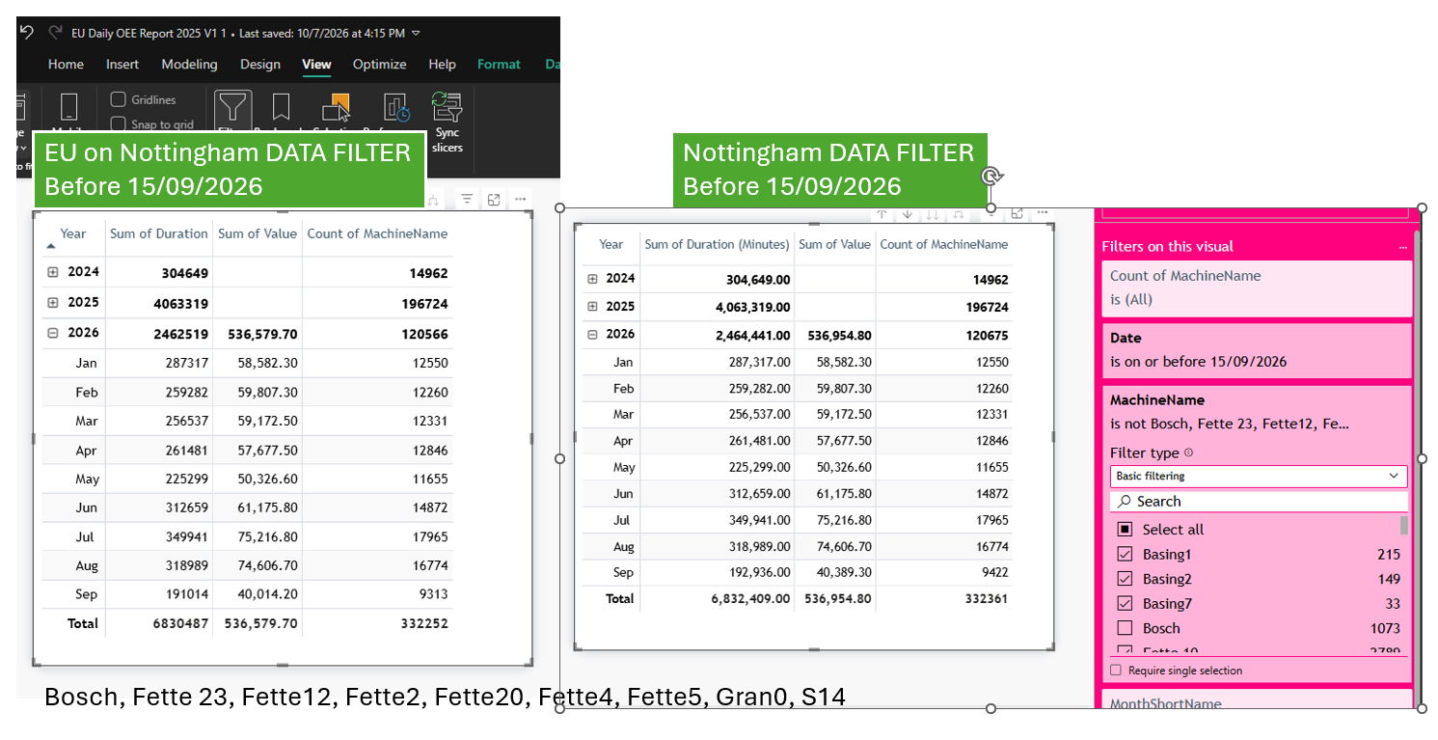
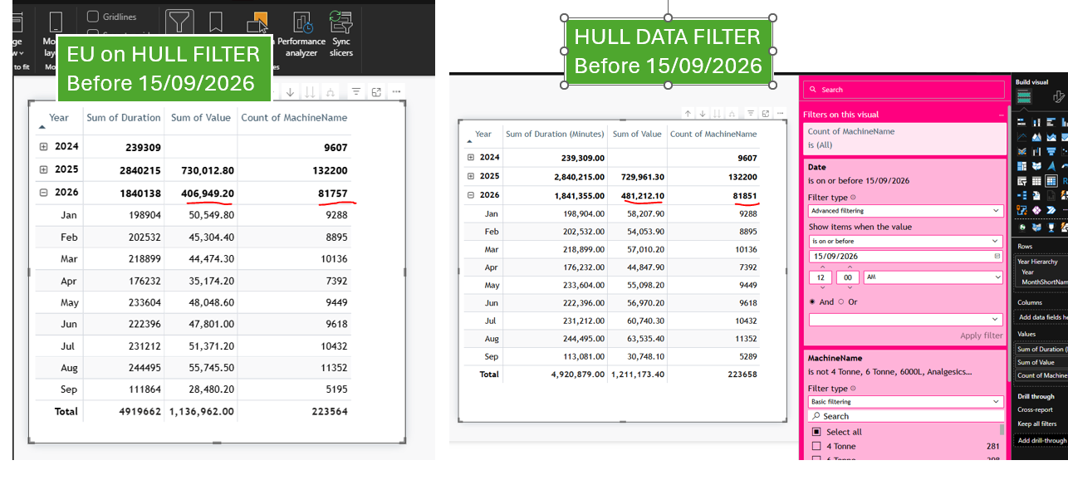
Daily Losses: the EU rule closes the volume gap
Site reports with the EU machine rule applied in the visual filter
Hull: EU vs site + 19 machines out
Nottingham: EU vs site + 9 machines out
Hull: Duration +0.02%, stops +0.04%, Value +6.5% (glidepath).
Nottingham: Duration +0.03%, stops +0.03%, Value +0.07%.
EU vs site OEE reports | data cut 15 Sep 2026
4

Slide 5
All three tables: gap to the EU, before and after the EU rule
Site total vs EU total, Dec 2024 to 15 Sep 2026
 | Before | After
Hull losses duration | +40.21% | +0.02%
Hull Plan OPT Good Parts | +42.38% | 0.00%
Hull TU OEE Time | +42.47% | 0.00%
Notts losses duration | +13.50% | +0.03%
Notts Plan OPT Good Parts | +4.80% | 0.00%
Notts TU OEE Time | +126.84% | –0.01%
Plan OPT times in the EU stay about 0.1% lower: the union step drops the seconds.
EU vs site OEE reports | data cut 15 Sep 2026
5

Slide 6
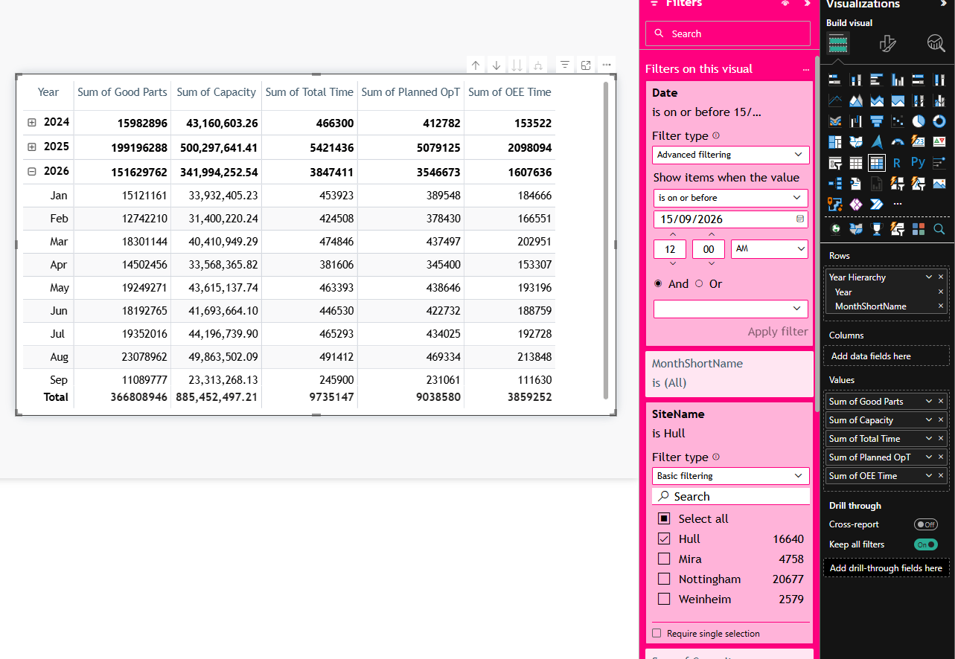
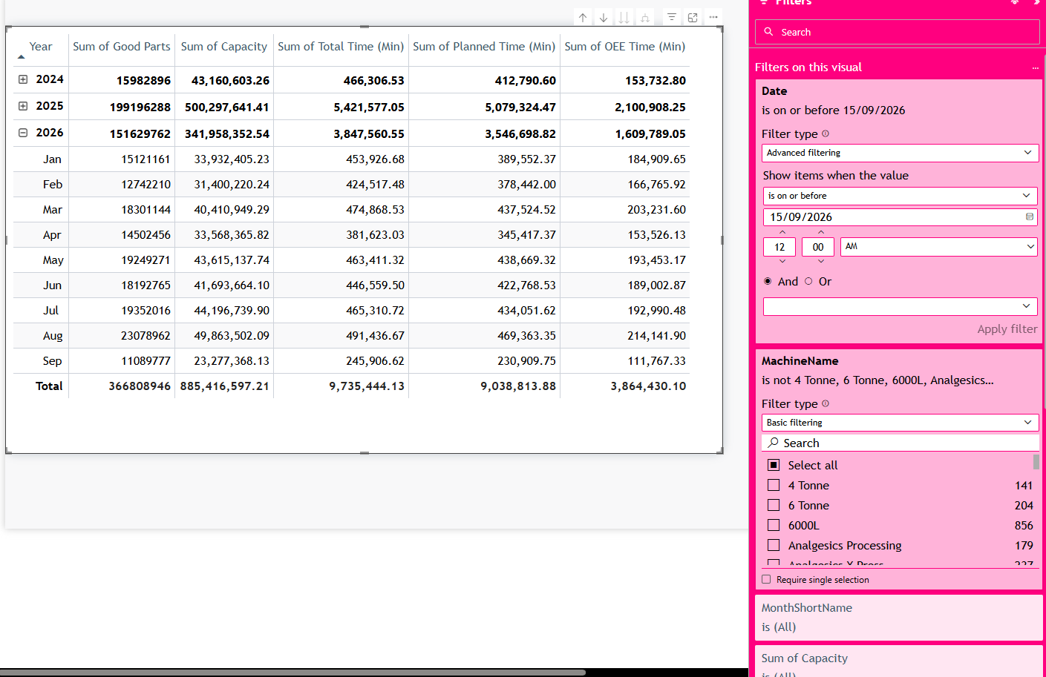
Plan OPT: the EU rule closes the volume gap
EU report next to the site report with the EU rule applied
EU Plan OPT, Hull
Hull site Plan OPT, 19 machines out
Hull: Good Parts 366,808,946 on both sides (site as-is +42%). EU OEE Time 0.13% lower: seconds dropped.
Nottingham (23 packing machines): Good Parts 621,276,541 on both sides (site as-is +4.8%).
EU vs site OEE reports | data cut 15 Sep 2026
6

Slide 7
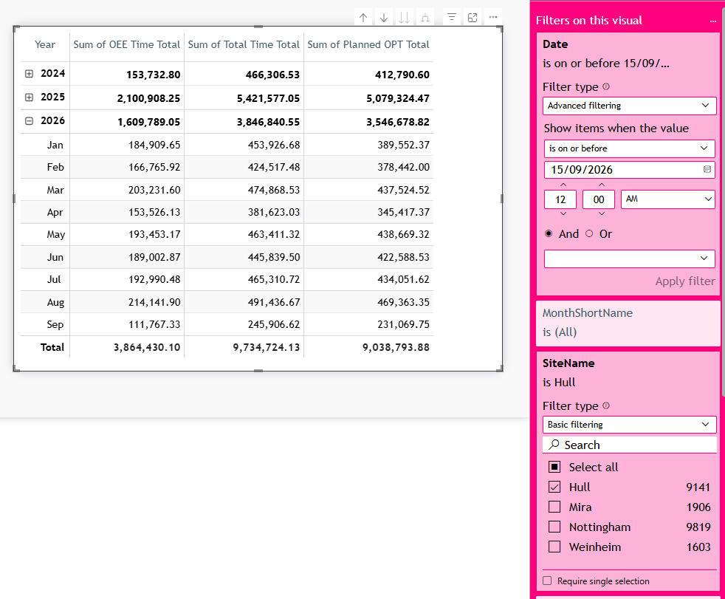
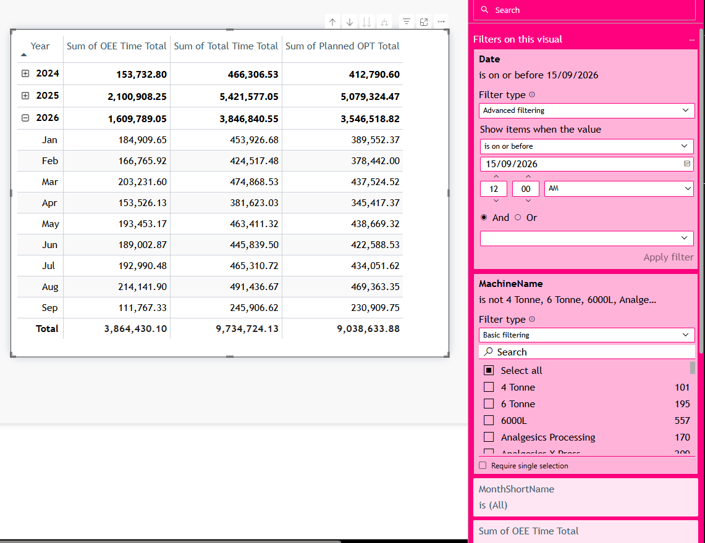
Time Utilisation: the EU rule closes the volume gap
EU report next to the site report with the EU rule applied
EU Time Utilisation, Hull
Hull site Time Utilisation, 19 machines out
Hull: OEE Time Total 3,864,430.10 on both sides (site as-is +42%).
Nottingham (23 machines): OEE Time Total 5,281,793.65 site vs 5,282,267.52 EU (site as-is +127%).
EU vs site OEE reports | data cut 15 Sep 2026
7

Slide 8
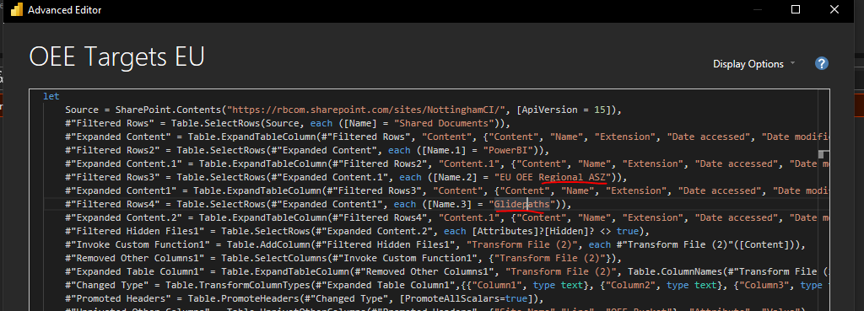
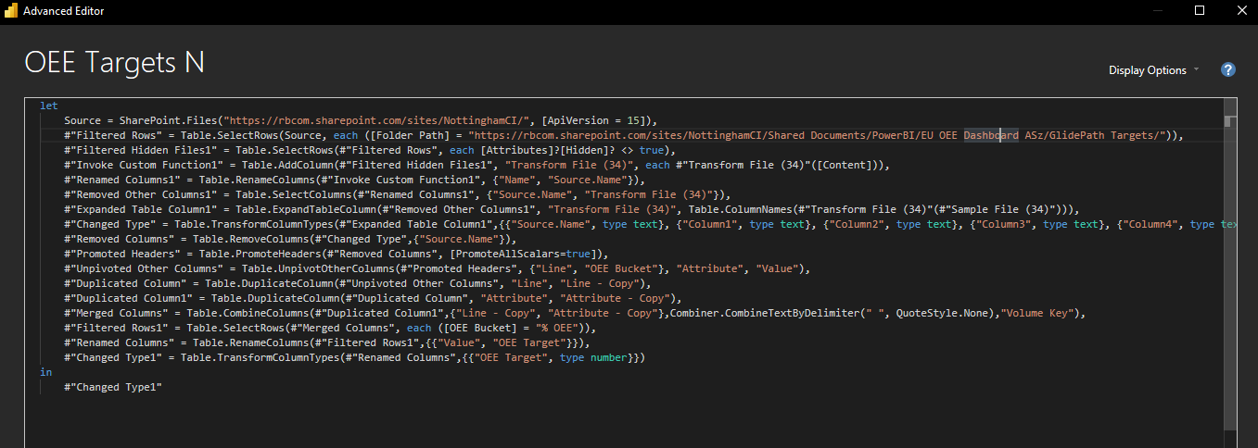
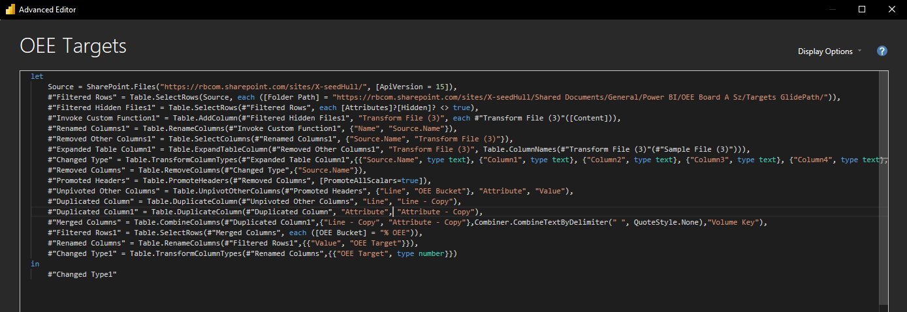
Three reports, three glidepath folders
Source step of the target query in each .pbix
EU report: EU OEE Regional ASZ / Glidepaths
Nottingham site: EU OEE Dashboard ASz / GlidePath Targets
Hull site: X-seedHull / Targets GlidePath
A site that updates its own glidepath does not change the EU report unless the same change is copied into the regional folder.
EU vs site OEE reports | data cut 15 Sep 2026
8

Slide 9
Glidepath files compared cell by cell
Same line, OEE bucket and month
Hull 2026
▪ 818 targets differ, e.g. T1 % OEE Jan 2026: regional 44.7, site 47.7.
▪ SP1, SP2 only in the site file (5,094 and 2,135 stops in 2026).
▪ Saloon only in the regional file.
▪ Result: Hull Value 6.5% apart.
Nottingham
▪ Same targets. Only the two Downtime totals differ, by exactly 100× (site 0.147, regional 14.7).
EU vs site OEE reports | data cut 15 Sep 2026
9

Slide 10
Reconciliation options
One scope rule and one glidepath file per site
Machine scope
Glidepath
▪ Option 1: use the site data as it is. EU totals go up.
▪ Option 2: one 'In EU Report' rule per site and machine, the same for all three tables.
▪ Ask: why are these machines out, and should Nottingham losses follow the packing-only rule?
▪ Which one is the correct Glidepath
▪ Ask: who owns the folder, and how often do targets change?
EU vs site OEE reports | data cut 15 Sep 2026
10

